Slide 1
Bayesian Networks

Slide 2
Applications with uncertainty
Medical diagnosis
Not always an obvious cause/effect relationship between the symptoms presented by the patient and the causes of these symptoms
The same sets of symptoms from multiple causes
Natural language understanding
Words, expressions, and metaphors are learned, but also change and evolve as they are used over time.
Planning and scheduling
When an agent forms a plan (e.g., a vacation trip by car), often no deterministic sequence of operations is guaranteed to succeed
Car can car breaks down, the car ferry is cancelled, a hotel is fully booked even though a reservation was made
Learning
An important component of many stochastic systems is that they have the ability to sample situations and learn over time

Slide 3
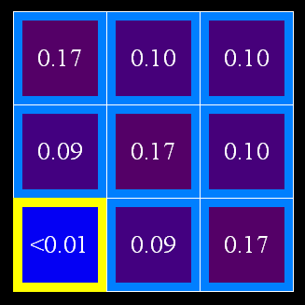

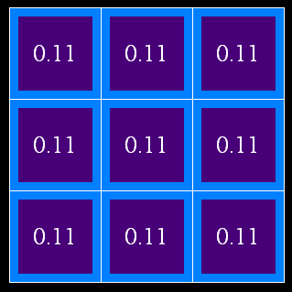
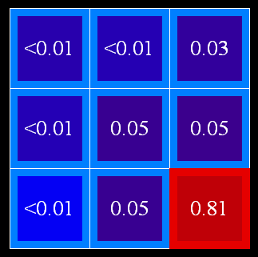
Uncertainty
General situation:
Observed variables (evidence/fact): Agent knows certain things about the state of the world (e.g., sensor readings or symptoms or weather now)
Unobserved variables: Agent needs to reason about other aspects (e.g. where an object is or what disease is present or weather tomorrow)
Model: Agent knows something about how the known variables relate to the unknown variables
Probabilistic reasoning gives us a framework for managing our beliefs and knowledge

Slide 4

Random Variables
A random variable is some aspect of the world about which we (may) have uncertainty
R = Is it raining?
T = Is it hot or cold?
D = How long will it take to drive to work?
L = Where is the ghost (Pacman project)?
We denote random variables with capital letters
Random variables have domains
R in {true, false} (often write as {+r, -r})
T in {hot, cold}
D in [0, ∞)
L in possible locations, maybe {(0,0), (0,1), …}

Slide 5
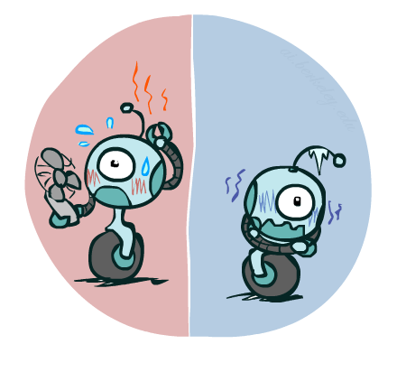
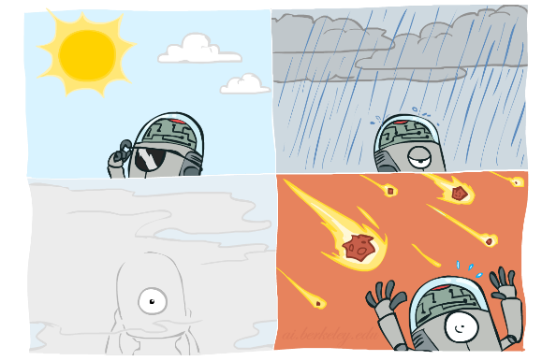


Probability Distributions
Associate a probability with each value
Temperature:
Weather:
W | P
sun | 0.6
rain | 0.1
fog | 0.3
meteor | 0.0
T | P
hot | 0.5
cold | 0.5

Slide 6


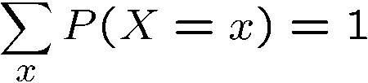
Probability Distributions
Unobserved random variables have distributions
A distribution is a TABLE of probabilities of values
A probability (lower case value) is a single number
Must have: and
Shorthand notation:
OK if all domain entries are unique
T | P
hot | 0.5
cold | 0.5
W | P
sun | 0.6
rain | 0.1
fog | 0.3
meteor | 0.0

Slide 7




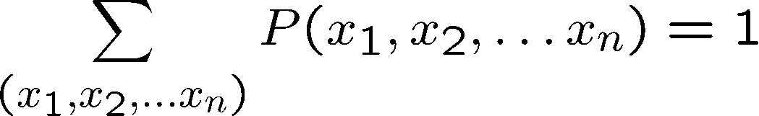
Joint Distributions
A joint distribution over a set of random variables:
specifies a real number for each outcome:
Must obey:
Size of distribution if n variables with domain sizes d?
For all but the smallest distributions, impractical to write out!
T | W | P
hot | sun | 0.4
hot | rain | 0.1
cold | sun | 0.2
cold | rain | 0.3
P(a,b)
P(a)
P(b)
Notes:
A probabilistic model is a joint distribution over a set of random variables
Probabilistic models:
(Random) variables with domains
Joint distributions: say whether outcomes are likely
Normalized: sum to 1.0
Ideally: only certain variables directly interact
d^n

Slide 8
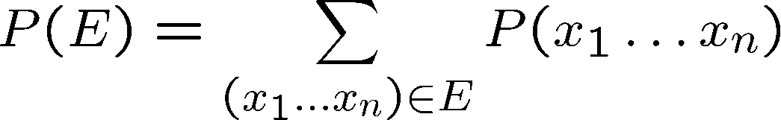
Events and Sample Space
An event is a set E of outcomes
From a joint distribution, we can calculate the probability of any event
Probability that it’s hot AND sunny?
Probability that it’s hot?
Probability that it’s hot OR sunny?
T | W | P
hot | sun | 0.4
hot | rain | 0.1
cold | sun | 0.2
cold | rain | 0.3

Slide 9

Student Participation: Events
P(+x, +y) ?
P(+x) ?
P(-y OR +x) ?
X | Y | P
+x | +y | 0.2
+x | -y | 0.3
-x | +y | 0.4
-x | -y | 0.1
Notes:
0.2
0.5
0.6

Slide 10
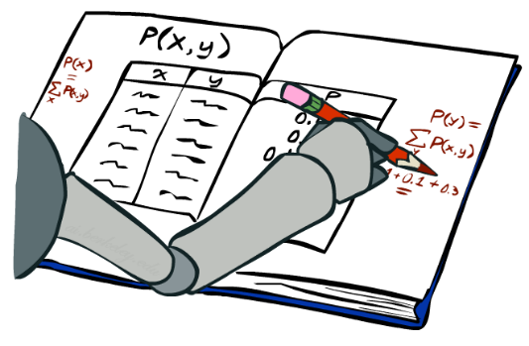
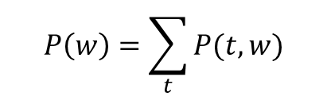
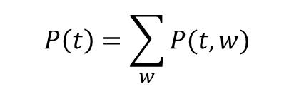
Marginal Distributions
Typically, the events we care about are partial outcomes, like P(T=hot)
The set of all possible outcomes of an event E is its sample space
The sample space for it’s hot = {it’s hot and sun, it’s hot and rain}
Marginal distributions are sub-tables which eliminate variables
Marginalization (summing out): Combine collapsed rows by adding
T | P
hot | 0.5
cold | 0.5
T | W | P
hot | sun | 0.4
hot | rain | 0.1
cold | sun | 0.2
cold | rain | 0.3
$$P\left(t\right)=\sum_{w}{P(t,w)}$$
$$P\left(w\right)=\sum_{t}{P(t,w)}$$
W | P
sun | 0.6
rain | 0.4

Slide 11

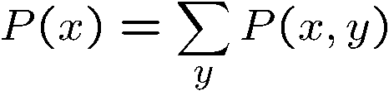

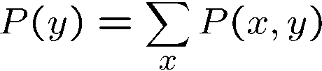
Student Participation : Marginal Distributions
X | P
+x
-x
X | Y | P
+x | +y | 0.2
+x | -y | 0.3
-x | +y | 0.4
-x | -y | 0.1
Y | P
+y
-y
Notes:
0.5
0.5
0.6
0.4

Slide 12
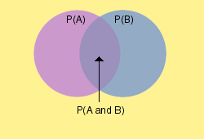
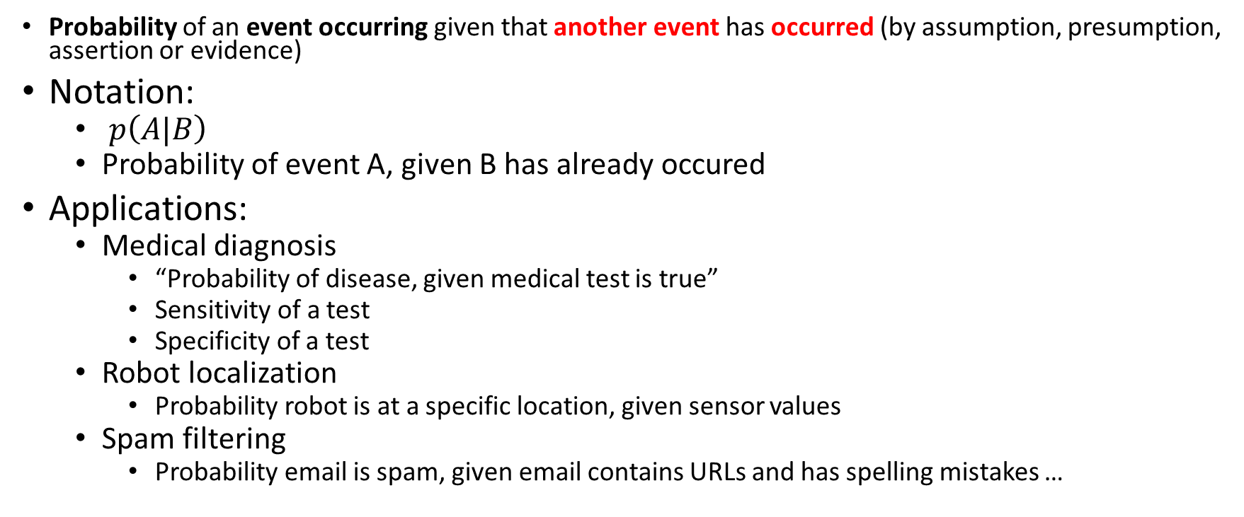
Conditional Probability
Probability of an event occurring given that another event has occurred (by assumption, presumption, assertion or evidence)
Notation:
$p\left(A|B\right)$
Probability of event A, given B has already occured
Applications:
Medical diagnosis
“Probability of disease, given medical test is true”
Sensitivity of a test
Specificity of a test
Robot localization
Probability robot is at a specific location, given sensor values
Spam filtering
Probability email is spam, given email contains URLs and has spelling mistakes …

Slide 13
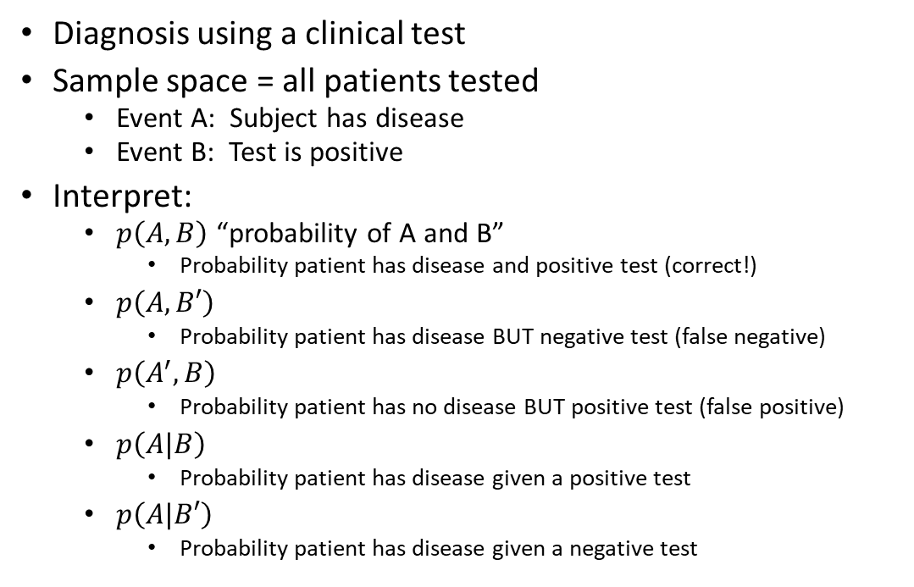
Conditional Probability Example
Diagnosis using a clinical test
Sample space = all patients tested
Event A: Subject has disease
Event B: Test is positive
Interpret:
$p\left(A,B\right)$ “probability of A and B”
Probability patient has disease and positive test (correct!)
$p\left(A,B′\right)$
Probability patient has disease BUT negative test (false negative)
$p\left(A^{′},B\right)$
Probability patient has no disease BUT positive test (false positive)
$p\left(A|B\right)$
Probability patient has disease given a positive test
$p\left(A|B′\right)$
Probability patient has disease given a negative test

Slide 14
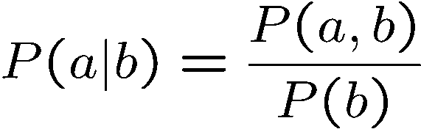
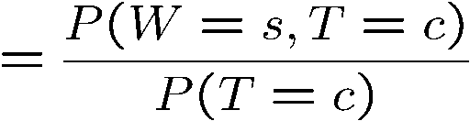
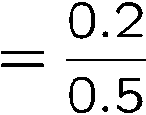



Conditional Probabilities
A simple relation between joint and conditional probabilities
In fact, this is taken as the definition of a conditional probability
P(a,b)
P(a)
P(b)
T | W | P
hot | sun | 0.4
hot | rain | 0.1
cold | sun | 0.2
cold | rain | 0.3

Slide 15
Student Participation: Conditional Probabilities
P(+x | +y) ?
P(-x | +y) ?
P(-y | +x) ?
X | Y | P
+x | +y | 0.2
+x | -y | 0.3
-x | +y | 0.4
-x | -y | 0.1
Notes:
0.2/(0.2+0.4)= 1/3
0.4/(0.2+0.4)=2/3
0.3/(0.2+0.3)=0.6

Slide 16
Exercise Questions for Probability
Scenario:
We toss a fair coin three successive times. What is the probability of seeing more heads than tails coming up when the first toss is a head?
Q1: What is the sample space?
Q2: What are the random variables?
Q3: What are the events and the probabilities of each event?
Q4: What are the conditional probabilities?
Notes:
Q1:What is the sample space?
S = {HHH, HHT, HTH, HTT, THH, THT, TTH, TTT}
Q2: What are the events and the probabilities of each event?
A = {more heads than tails coming up} and B = {1st toss is a head}
P(A) = 4/8, P(B) = 4/8
Q3: What are the random variables?
Measurements of interest for any coin tossing event, e.g., A and B.
Q4: What is the conditional probability and how can we compute it?
P(A|B) = P(A∩B)/P(B) = (3/8)/(4/8) = ¾
Or P(A|B) can be simply calculated by dividing the number of elements for A∩B by the number of elements for B.
When the first toss is H.
The rest are HH, HT, TH, TT. So 3/4

Slide 17
Exercise Questions for Probability
Scenario:
We toss a fair coin three successive times. What is the probability of seeing more heads than tails coming up when the first toss is a head?
Q1: What is the sample space?
{(HHH),(HHT),(HTT),(THH),(TTH),(THT),(HTH),(TTT)}
Q3: What are the random variables?
seeing more heads than tails coming up: A
the first toss is a head :B
Q2: What are the events and the probabilities of each event?
(HHH): A=true, B=true +a, +b
(HHT): A=true, B=true +a, +b
(HTT): -a, +b
(THH): +a, -b
(TTH): -a, -b
(THT): -a, -b
(HTH): +a, +b
(TTT): -a, -b
Q4: What are the conditional probabilities?
P(A=+a|B=+b) = ?
A | B | prob
+a | +b | 3/8
+a | -b | 1/8
-a | +b | 1/8
-a | -b | 3/8
Notes:
Q1:What is the sample space?
S = {HHH, HHT, HTH, HTT, THH, THT, TTH, TTT}
Q2: What are the events and the probabilities of each event?
A = {more heads than tails coming up} and B = {1st toss is a head}
P(A) = 4/8, P(B) = 4/8
Q3: What are the random variables?
Measurements of interest for any coin tossing event, e.g., A and B.
Q4: What is the conditional probability and how can we compute it?
P(A|B) = P(A∩B)/P(B) = (3/8)/(4/8) = ¾
Or P(A|B) can be simply calculated by dividing the number of elements for A∩B by the number of elements for B.
When the first toss is H.
The rest are HH, HT, TH, TT. So 3/4

Slide 18
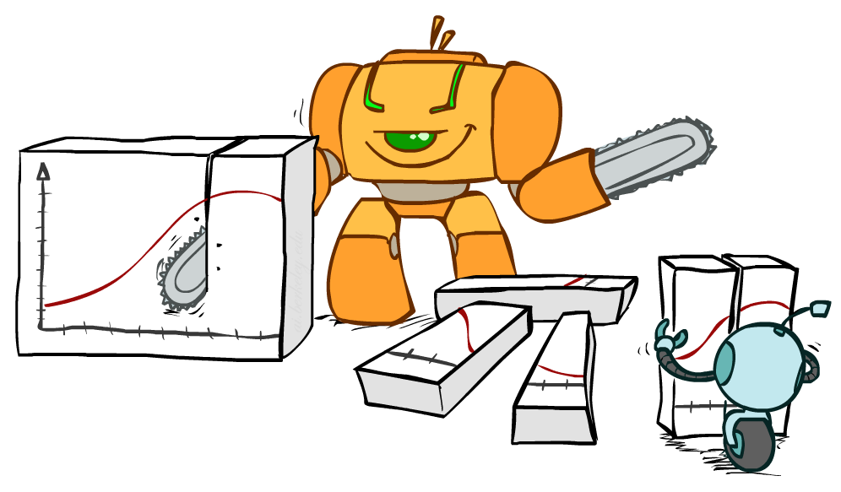
Bayes Rule

Slide 19


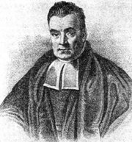
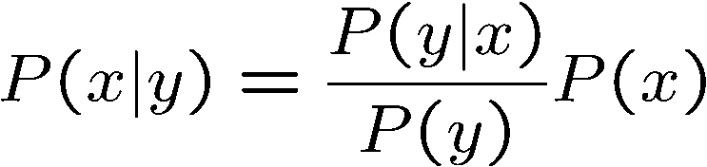
Bayes’ Rule
Two ways to factor a joint distribution over two variables: p(x, y) = p(y, x)
Dividing, we get:
Why is this at all helpful?
Lets us build one conditional from its reverse
Often one conditional is tricky but the other one is simple
Foundation of many systems
In the running for most important AI equation!
That’s my rule!

Slide 20
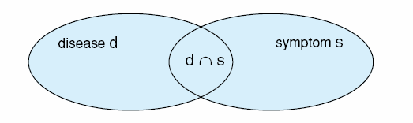

Interpretation of Bayes rule
Cause
Effect
Medical diagnosis system: study the relationship between disease and symptom
p(d|s) means the probability of the disease d given symptom s.
In many cases, it is difficult to know p(d|s)
If we know what the disease (or cause) is, telling those symptoms (or effect) of the disease, is much easier than figuring out a disease based on symptoms
s can be the result of a medical test
p(s|+d) is test’s sensitivity: TP/ (TP+FN)
p(s|-d) is test’s false positive rate: TP/ (TP+FN)
p(d) is occurrence of disease
Bayes’ rule
Notes:
P(s|d): via medical tests and observation
Example: common cold and fever; running nose, cough, ear infe
So we can change the calculations of p(d|s) as a function of p(s|d), $p\left(d | s\right)= \frac{p\left(s | d\right)p(d)}{p(s)}$ction

Slide 21





Law of Total Probability
$$A_{1}$$
$$A_{2}$$
$$A_{3}$$
Take events A_{i} for i = 1 to k to be:
Mutually exclusive: $A_{i}∩A_{j}=0, i≠j$
Exhaustive: $A_{i}∪…∪A_{k}=S$
For any event B on S
Bayes rule
$$B$$

Slide 22
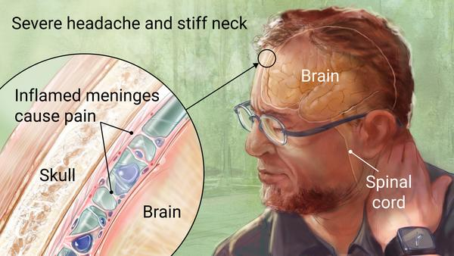
Inference with Bayes’ Rule
Example: Diagnostic probability from causal probability:
Example:
M: meningitis, S: stiff neck
Note: posterior probability of meningitis still very small
Note: you should still get stiff necks checked out! Why?
Example
givens

Slide 23
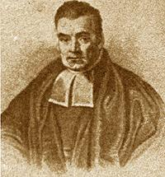
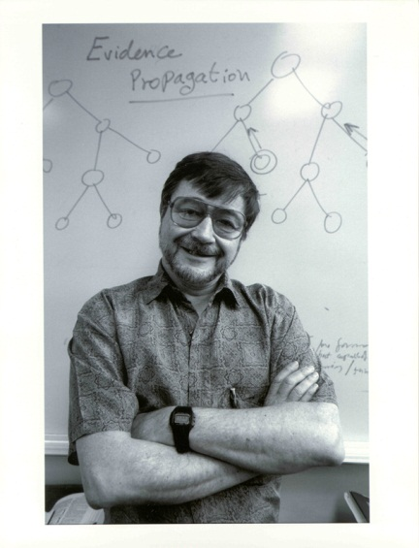
Bayesian Network Motivation
We want a representation and reasoning system that is based on conditional independence
Compact yet expressive representation
Efficient reasoning procedures
Bayesian Networks are such a representation
Named after Thomas Bayes (ca. 1702 –1761)
Term coined in 1985 by Judea Pearl (1936 – )
Turing Award winner, 2011
Invention changed the focus on AI from logic to probability!
Thomas Bayes
Judea Pearl

Slide 24
What are Bayesian networks?
Bayesian networks (BN) are a graph-based framework for representing and analyzing models involving uncertainty
BN are different from other knowledge-based systems tools because uncertainty is handled in a mathematically rigorous yet efficient and simple way
BN are different from other probabilistic analysis tools because of network representation of problems and use of Bayesian statistics

Slide 25
Concept of a Bayesian Network
Graph-based knowledge structure:
Nodes: variables
Edges: represent probabilistic dependence between variables
conditional probabilities encode the strength of the dependencies
Computational architecture:
computes posterior probabilities given evidence about some nodes
exploits probabilistic independence for efficient computation

Slide 26
“Icy roads” example
A road can be icy or not
There is a chance that driving on that road will result in an accident
Accident is much more likely if road is icy
Consider two people, A and B, driving on that road

Slide 27
Road=Icy/Not icy
A has crashed/not crashed
B has crashed/not crashed

Slide 28
“Icy roads” example
Initially, don’t know if road is icy, or if A/B had an accident
You learn that A had an accident
What can we say about the condition of the road and B’s chances of an accident?
Our thinking:
“If A has crashed, then it probably means the roads are icy, and so it is more likely that B will have an accident”
The probability that B will have an accident has increased given this information

Slide 29
Road=Icy/Not icy
Evidence
A has crashed/not crashed
B has crashed/not crashed

Slide 30
“Icy roads” example
You now find out that roads are not icy
Our thinking:
“A was just unlucky; B will probably not have an accident”
The probability that B will have an accident has decreased given this information

Slide 31
Evid.
Road=Icy/Not icy
Evid.
A has crashed/not crashed
B has crashed/not crashed

Slide 32
The Joint Probability Distribution
Joint probabilities can be between any number of variables
eg. P(A = true, B = true, C = true)
For each combination of variables, we need to say how probable that combination is
The probabilities of these combinations need to sum to 1
A | B | C | P(A,B,C)
false | false | false | 0.1
false | false | true | 0.2
false | true | false | 0.05
false | true | true | 0.05
true | false | false | 0.3
true | false | true | 0.1
true | true | false | 0.05
true | true | true | 0.15
Sums to 1

Slide 33
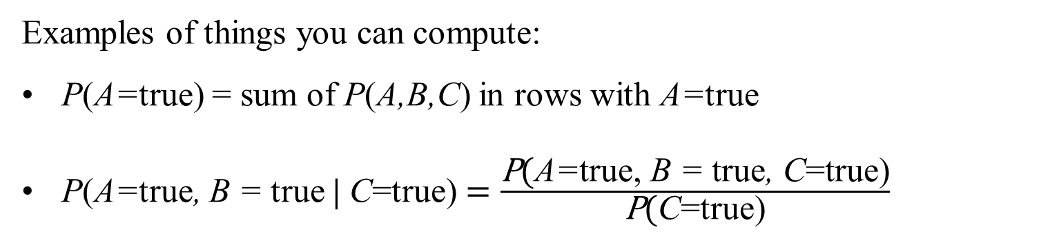
The Joint Probability Distribution
A | B | C | P(A,B,C)
false | false | false | 0.1
false | false | true | 0.2
false | true | false | 0.05
false | true | true | 0.05
true | false | false | 0.3
true | false | true | 0.1
true | true | false | 0.05
true | true | true | 0.15
Once you have the joint probability distribution, you can calculate any probability involving A, B, and C
Note: use marginalization and definition of conditional probability
Examples of things you can compute:
P(A=true) = sum of P(A,B,C) in rows with A=true
P(A=true, B = true $\text{|}$ C=true) $=\frac{\text{P}\text{(}\text{A}\text{=}\text{true}\text{,} \text{B}\text{ = }\text{true}\text{,} \text{C}\text{=}\text{true}\text{)}}{\text{P}\text{(}\text{C}\text{=}\text{true}\text{)}}$

Slide 34
Marginalization
To get probability without a variable A:
Sum up all rows containing different values of A, without changing other variable values

Slide 35
Marginalization
Road is icy? | A has accident? | B has accident? | P(Road is icy?, A has accident?, B has accident?)
False | False | False | 0.648
False | False | True | 0.072
False | True | False | 0.072
False | True | True | 0.008
True | False | False | 0.098
True | False | True | 0.042
True | True | False | 0.042
True | True | True | 0.018

Slide 36
Classwork: Compute
(Prior) probability that A has accident
Probability that A has accident if it is known that the road is icy
Probability that A has accident if it is known that B had an accident (and it is not known if the road is icy or not)
Probability that A has accident if it is known that B had an accident and Road is not icy

Slide 37
Classwork: Compute
(Prior) probability that A has accident
P(A=true)
= 0.072+0.08+0.042+0.018 = 0.14
Probability that A has accident if it is known that the road is icy
P(A=true|Icy=true) = P(A=true,Icy=true)/P(Icy=true)
= (0.042+0.018)/(.098 + .042 + .042 + .018) = 0.06/0.2 = 0.3
Probability that A has accident if it is known that B had an accident (and it is not known if the road is icy or not)
P(A=true|B=true) = P(A=true,B=true)/P(B=true)
= (0.008+0.018)/(0.072+0.008+0.042+0.018) = 0.1857
Probability that A has accident if it is known that B had an accident and Road is not icy
P(A=true|B=true, Icy=false) = P(A=true,B=true, Icy=false) /P(B=true, Icy=false)
=0.008/(0.072+0.008) = 0.1

Slide 38
The Problem with the Joint Distribution
Lots of entries in the table
For k Boolean random variables, table of size 2^{k}
How do we use fewer numbers?
Exploit the concept of conditional independence
A | B | C | P(A,B,C)
false | false | false | 0.1
false | false | true | 0.2
false | true | false | 0.05
false | true | true | 0.05
true | false | false | 0.3
true | false | true | 0.1
true | true | false | 0.05
true | true | true | 0.15

Slide 39
Bayesian network: A Directed Acyclic Graph
Each node in the graph is a random variable
A node X is a parent of another node Y if there is an arrow from node X to node Y eg. A is a parent of B
A
B
C
D
Informally, an arrow from node X to node Y means X has a direct influence on Y

Slide 40
A Bayesian Network
A Directed Acyclic Graph
A node represents a variable
A conditional probability table for each node
Each node X_{i} has a conditional probability distribution P(X_{i} | Parents(X_{i})) that quantifies the effect of the parents on the node
A | P(A)
false | 0.6
true | 0.4
P(+a) | P(-a)
0.4 | 0.6
A
A | P(+b|A) | P(-b|A)
false | 0.99 | 0.01
true | 0.3 | 0.7
A | B | P(B|A)
false | false | 0.01
false | true | 0.99
true | false | 0.7
true | true | 0.3
B | C | P(C|B)
false | false | 0.4
false | true | 0.6
true | false | 0.9
true | true | 0.1
B
C
D
B | D | P(D|B)
false | false | 0.02
false | true | 0.98
true | false | 0.05
true | true | 0.95
B | P(+d|B)
false | 0.98
true | 0.95
B | P(+c|B)
false | 0.6
true | 0.1

Slide 41
Examples of 3-way Bayesian Networks
P(+a)
0.4
P(+b)
0.75
P(+c)
0.33
A
B
C
Absolute Independence:
p(A,B,C) = p(A) p(B) p(C)
What do the 3 tables look like?
Assume all variables are binary

Slide 42

Examples of 3-way Bayesian Networks
Independent Causes
$\text{A} \text{and} \text{B} \text{are} \text{independent}$
$\text{A} \text{and} \text{B} \text{become} \text{dependent} \text{once} \text{C} \text{is} \text{known}$
e.g., A is “exposure to toxins”, B is “exposure to radiation”
C is “cancer”
$$p(A,B,C) =p(A)p(B)p(C|A,B)$$
P(+a)
0.4
P(+b)
0.1
A
B
C
A | B | P(+c|A,B)
T (+a) | T (+b) | 0.90
T | F | 0.25
F (-a) | T | 0.40
F | F | 0.15
What do the 3 tables look like?
Assume all variables are binary

Slide 43
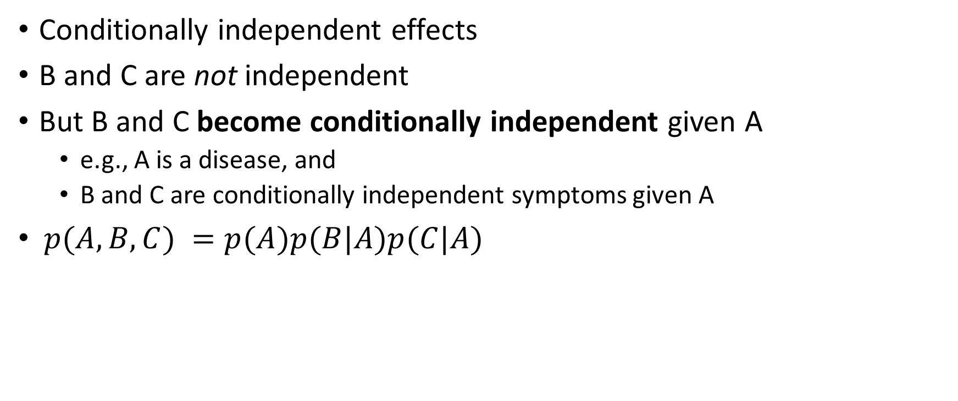
Examples of 3-way Bayesian Networks
Conditionally independent effects
B and C are not independent
But B and C become conditionally independent given A
e.g., A is a disease, and
B and C are conditionally independent symptoms given A
$p(A,B,C) =p(A)p(B|A)p(C|A)$
P(+a)
0.01
A
B
C
A | P(+b|A)
false | 0.10
true | 0.95
A | P(+c|A)
false | 0.05
true | 0.90
What do the 3 tables look like?
Assume all variables are binary

Slide 44
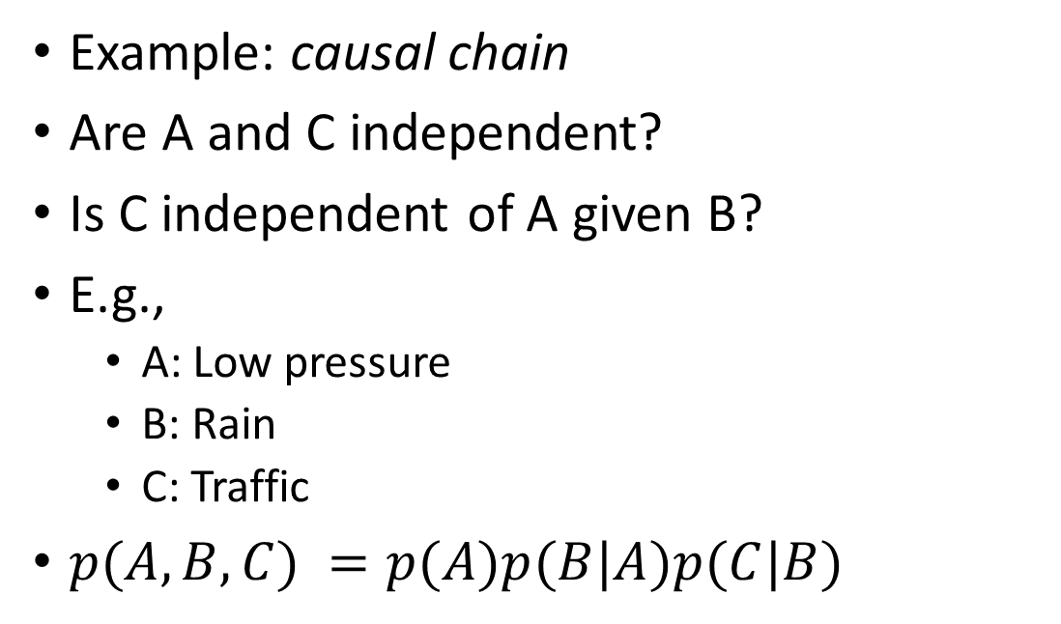
Examples of 3-way Bayesian Networks
Example: causal chain
Are A and C independent?
Is C independent of A given B?
E.g.,
A: Low pressure
B: Rain
C: Traffic
$p(A,B,C) =p(A)p(B|A)p(C|B)$
P(+a)
0.01
A
A | P(+b|A)
false | 0.10
true | 0.95
B
C
B | P(+c|B)
false | 0.05
true | 0.90
What do the 3 tables look like?
Assume all variables are binary

Slide 45

The Chain Rule
The product rule
$$P\left(X_{1},X_{2}\right)=P\left(X_{1}\right)P(X_{2}|X_{1})$$
More generally, can always write any joint distribution as an incremental product of conditional distributions
$$P\left(X_{1},X_{2},X_{3}\right)=P\left(X_{1}\right)P\left(X_{2} | X_{1}\right)P\left(X_{3} | X_{1},X_{2}\right)$$
$$P\left(X_{1},X_{2},{…,X}_{n}\right)=\prod_{i=1}^{n}{P\left(X_{i} | X_{1},…, X_{i−1}\right)}$$
Notes:
P(x1,x2)p(x3|x1,x2)

Slide 46
Conditional independence
A variable (node) is conditionally independent of its non-descendants given its parents
Age
Gender
Non-descendants
Cancer is independent of Age and Gender given Exposure to Toxics and Smoking
Exposure to Toxics
Smoking
Parents
Cancer
P is conditionally independent of Q if
Q is a non-descendant of P
given all parents(P)
Serum Calcium
Lung tumor
Descendants

Slide 47
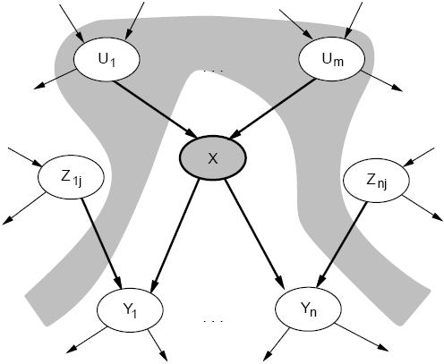
Conditional Independence
A node (X) is conditionally independent of its non-descendants (Z_{1j}, Z_{nj}), given its parents (U₁, U_{m}).

Slide 48
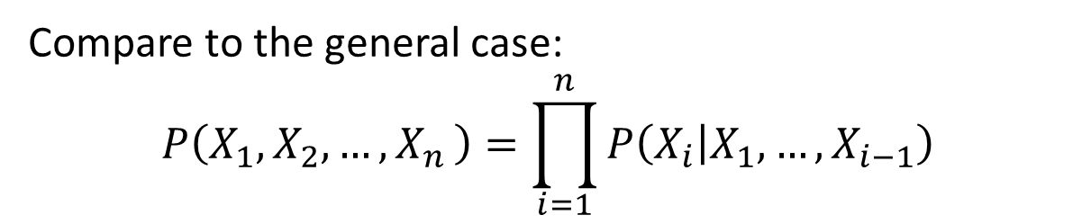
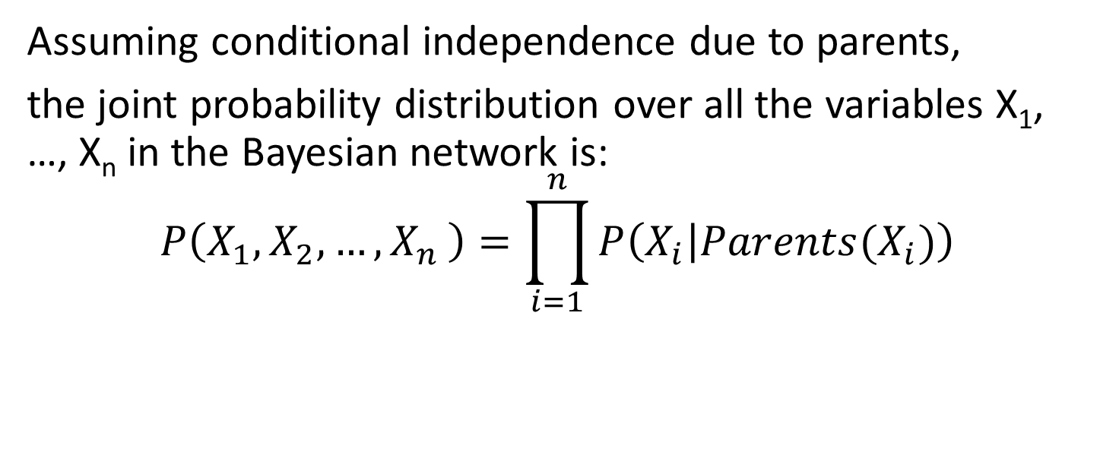
The Joint Probability Distribution
Assuming conditional independence due to parents,
the joint probability distribution over all the variables X₁, …, X_{n} in the Bayesian network is:
$$P\left(X_{1},X_{2},{…,X}_{n}\right)=\prod_{i=1}^{n}{P\left(X_{i} | Parents(X_{i})\right)}$$
Compare to the general case:
$$P\left(X_{1},X_{2},{…,X}_{n}\right)=\prod_{i=1}^{n}{P\left(X_{i} | X_{1},…, X_{i−1}\right)}$$

Slide 49
Using a Bayesian Network Example
Using the network in the example (Slide 21), suppose you want to calculate:
P(A = true, B = true, C = true, D = true)
= P(A = true) x P(B = true | A = true) x
P(C = true | B = true) x P( D = true | B = true)
= 0.4 x 0.3 x 0.1 x 0.95
This is from the graph structure
A | B | P(B|A)
false | false | 0.01
false | true | 0.99
true | false | 0.7
true | true | 0.3
A | P(A)
false | 0.6
true | 0.4
A
These numbers are from the conditional probability tables
B
B | D | P(D|B)
false | false | 0.02
false | true | 0.98
true | false | 0.05
true | true | 0.95
B | C | P(C|B)
false | false | 0.4
false | true | 0.6
true | false | 0.9
true | true | 0.1
C
D

Slide 50
What is the joint distribution represented by this BN?
P(+icy)
0.2
Road=Icy/Not icy
A has accident/ no accident
B has accident/ no accident
ICY | P(+a|ICY)
false | 0.1
true | 0.3
ICY | P(+b|ICY)
false | 0.1
true | 0.3

Slide 51
What is the joint distribution represented by this BN?
Road is icy? | A has accident? | B has accident? | P(Road is icy?, A has accident?, B has accident?)
False | False | False | 0.648
False | False | True | 0.072
False | True | False | 0.072
False | True | True | 0.008
True | False | False | 0.098
True | False | True | 0.042
True | True | False | 0.042
True | True | True | 0.018

Slide 52
Classwork: Using a Bayesian Network
A | P(+a)
true | 0.4
Using the network shown below, calculate:
P(A = true, B = false, C = false, D = true)
A
A | P(+b|A)
false | 0.99
true | 0.3
B
C
D
B | P(+c|B)
false | 0.6
true | 0.1
B | P(+d|B)
false | 0.98
true | 0.95

Slide 53
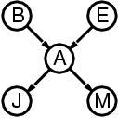
Compactness
Suppose we have a Boolean variable X_{i} with k Boolean parents. How many rows does its conditional probability table have?
2^{k} rows for all the combinations of parent values
Each row requires one number p for X_{i} = true
If each variable has no more than k parents, how many numbers does the complete network require?
O(n · 2^{k}) numbers – vs. O(2^{n}) for the full joint distribution

Slide 54
Inference
Using a Bayesian network to compute probabilities is called inference
In general, inference involves queries of the form:
P( X | E )
E = The evidence variable(s)
X = The query variable(s)

Slide 55
Inference
HasPneumonia
HasCough
HasFever
HasDifficultyBreathing
ChestXrayPositive
An example query:
P( HasPneumonia = true | HasFever = true, HasCough = true)?
Note: Even though HasDifficultyBreathing and ChestXrayPositive are in the Bayesian network, they are not given values in the query
Neither query variables nor evidence variables
They are treated as unobserved or hidden variables

Slide 56
Example from Medical Diagnostics
Visit to Asia
Smoking
Patient Information
Tuberculosis
Lung Cancer
Bronchitis
Medical Difficulties
Tuberculosis
or Cancer
XRay Result
Dyspnea (difficult breathing
Diagnostic Tests
Network represents a knowledge structure that models the relationship between medical difficulties, their causes and effects, patient information and diagnostic tests
From D.M. Buede, J.A. Tatman, T.A. Bresnick “Introduction to Bayesian Networks,” Tutorial for the 66th MORS Symposium

Slide 58
As a finding is entered, the propagation algorithm updates the beliefs attached to each relevant node in the network
Interviewing the patient produces the information that “Visit to Asia” is “Visit”
This finding propagates through the network and the belief functions of several nodes are updated

Slide 59
Further interviewing of the patient produces the finding “Smoking” is “Smoker”
This information propagates through the network

Slide 60
Finished with interviewing the patient, the physician begins the examination
The physician now moves to specific diagnostic tests such as an X-Ray, which results in a “Normal” finding which propagates through the network
Note that the information from this finding propagates backward and forward through the arcs

Slide 61
The physician also determines that the patient is having difficulty breathing, the finding “Present” is entered for “Dyspnea” and is propagated through the network
The doctor might now conclude that the patient has bronchitis and does not have tuberculosis or lung cancer

Slide 62
Inference in Bayesian networks
The general probabilistic inference problem is to find the probability of an event given a set of evidence
In theory:
Just construct the entire joint distribution and then marginalize (to remove variables not in the query)
Exponential in the number of variables
The full joint distribution includes every possible combination of variables
In time and space
In practice:
We need more efficient algorithms
Idea: no need to create the full joint distribution and then marginalize
Do marginalization (remove variables) before creating the joint distribution
Fewer variables -> smaller table
Variable Elimination algorithm

Slide 63
Inference in Bayesian networks
Variable Elimination algorithm
An exact inference algorithm for BNs
Worst-case exponential complexity, but practical for certain BNs
With low “tree-width”: informally, how far is the graph is from being a tree?
Intuitive idea:
Similar to simplification of algebraic formula with multiplication and addition
a b + a c + a d + a e h + a f h + a g h.
It takes 14 multiplications or additions to evaluate the expression
a (b + c + d + h*(e + f + g))
This expression only needs 7 operations

Slide 64

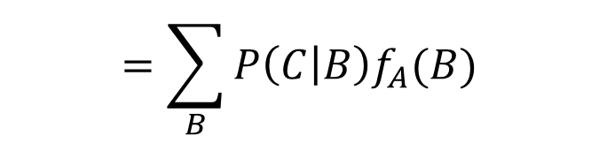



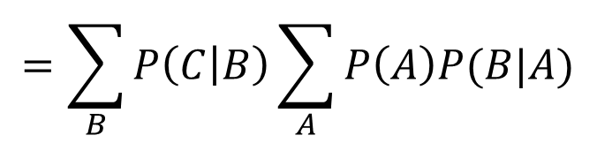
Variable Elimination: Example
A
A
B
C
We want to compute $P(C)$
Why is this better?
Fewer multiplications and additions
$$P\left(C\right)=\sum_{A}{\sum_{B}{P\left(A,B,C\right)=\sum_{A}{\sum_{B}{P\left(A\right)P\left(B | A\right)P(C|B)}}}}$$
$$=\sum_{B}{P\left(C | B\right)\sum_{A}{P\left(A\right)P(B|A)}}$$
Let’s call this $fA(B)$
$$=\sum_{B}{P\left(C | B\right)f_{A}(B)}$$
$A$has been (instantiated and) eliminated

Slide 65
Inference in Bayesian networks
Inexact inference
It is computationally expensive to make exact inference from a large and/or highly connected Bayes Network.
In these cases, we can approximate inferences by sampling.
Sampling is a technique to select and count the occurrences of the query and evidence variables to estimate the probability distributions in the network.

Slide 66
Applications of BNs
Diagnosis: P(cause|symptom)=?
Prediction: P(symptom|cause)=?
cause
cause
Classification: P(class|data)
Decision-making (given a cost function)
symptom
symptom
Medicine
Speech
recognition
Bio-informatics
Text
Classification
Stock market
Computer
troubleshooting

Slide 67
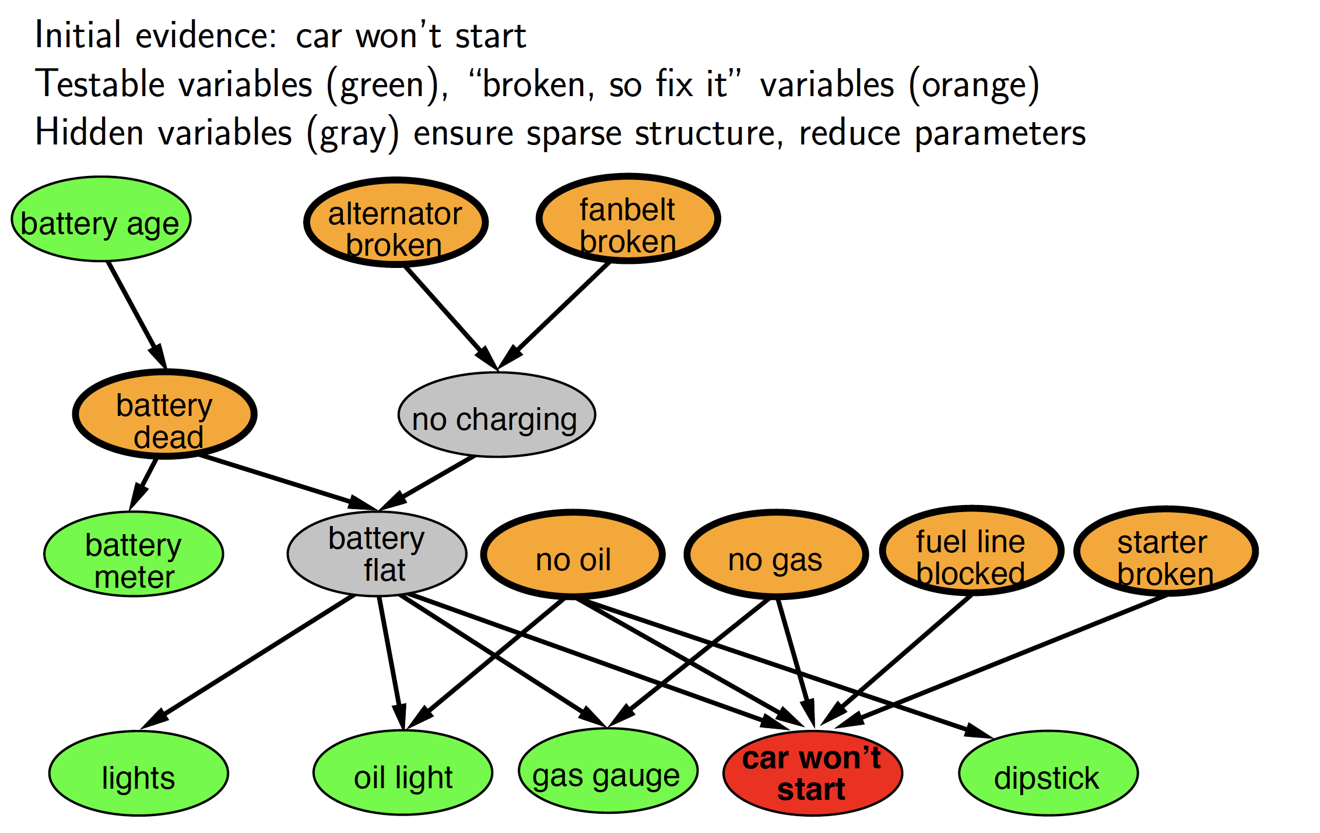
Application: car diagnosis
Russel and Norvig

Slide 68
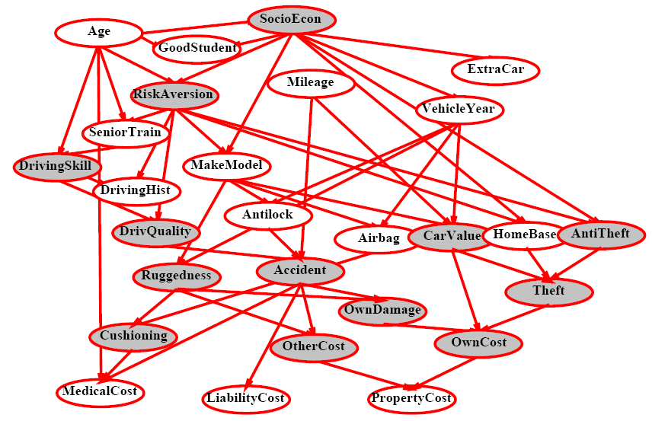
Car insurance

Slide 69
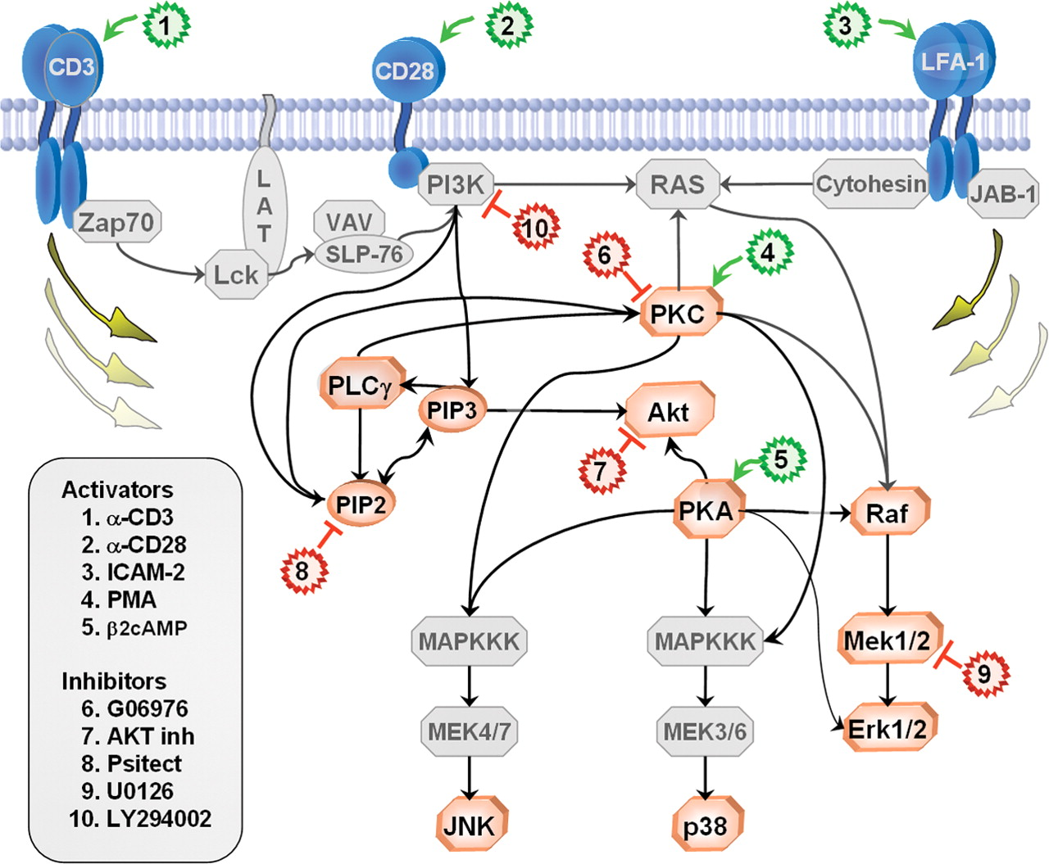
In research literature…
Causal Protein-Signaling Networks Derived from Multiparameter Single-Cell Data
Karen Sachs, Omar Perez, Dana Pe'er, Douglas A. Lauffenburger, and Garry P. Nolan
(22 April 2005) Science 308 (5721), 523.

Slide 70
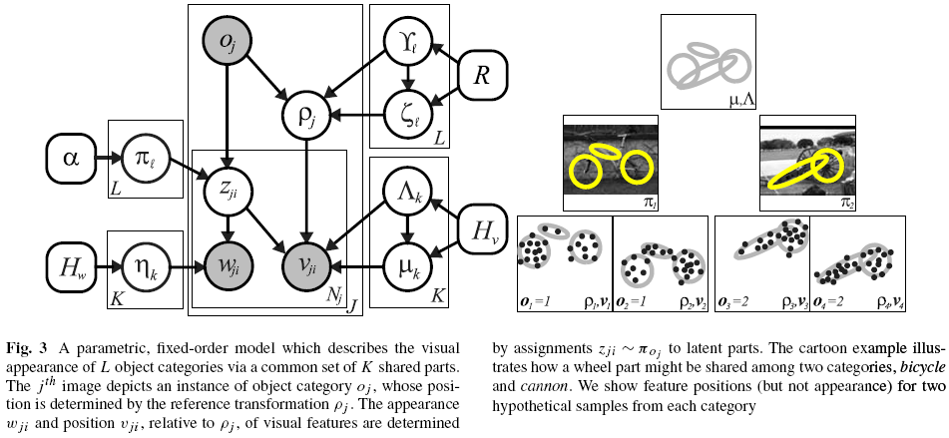
In research literature…
Describing Visual Scenes Using Transformed Objects and Parts
E. Sudderth, A. Torralba, W. T. Freeman, and A. Willsky.
International Journal of Computer Vision, No. 1-3, May 2008, pp. 291-330.

Slide 71
Advantages of BNs
<9.7 0.6 8 14 18>
<0.2 1.3 5 ?? ??>
<1.3 2.8 ?? 0 1 >
<?? 5.6 0 10 ??>
……………….
Combining domain expert knowledge with data
Efficient representation and inference
Handling missing data: Not all variable states need to be known in a query
Learning causal relationships:
S
C

Slide 72
How is the Bayesian network created?
Get an expert to design it
Expert must determine the structure of the Bayesian network
This is best done by modeling direct causes of a variable as its parents
Expert must determine the values of the CPT entries
These values could come from the expert’s informed opinion
Or an external source e.g. census information
Or they are estimated from data
Or a combination of the above
Learn it from data
This is a much better option but it requires a large amount of data

Slide 73
Constructing Bayesian networks
Choose an ordering of variables X₁, … , X_{n}
For i = 1 to n
add X_{i} to the network
select parents from X₁, … ,X_{i-1} such that P(X_{i} | Parents(X_{i})) = P(X_{i} | X₁, ... X_{i-1})

Slide 74

Example for BN construction: Fire Diagnosis
You want to diagnose whether there is a fire in a building
If there is a fire, there may be smoke
If there is a fire alarm, it may have been caused by a fire or by tampering
If everyone is leaving, this may have been caused by a fire alarm
You receive a noisy report about whether everyone is leaving the building

Slide 75
Example for BN construction: Fire Diagnosis
First you choose the variables. In this case, all are Boolean:
Fire is true when there is a fire
Smoke is true when there is smoke
Alarm is true when there is an alarm
Tampering is true when the alarm has been tampered with
Leaving is true if there are lots of people leaving the building
Report is true if the news reports that lots of people are leaving the building
Let’s construct the Bayesian network for this

Slide 76
Example for BN construction: Fire Diagnosis
Using the total ordering of variables:
(1)Fire, (2) Tampering, (3) Alarm, (4) Smoke, (5) Leaving, (6) Report
Choose the parents for each variable by evaluating conditional independencies
Fire is the first variable in the ordering. It does not have parents.
Tampering independent of fire (learning that one is true would not change your beliefs about the probability of the other)
Alarm depends on both Fire and Tampering: it could be caused by either or both
Smoke is caused by Fire, and so is independent of Tampering and Alarm given whether there is a Fire
Leaving is caused by Alarm, and thus is independent of the other variables given Alarm
Report is caused by Leaving, and thus is independent of the other variables given Leaving
Tampering
Fire
Alarm
Smoke
Leaving
Report

Slide 77
Example for BN construction: Fire Diagnosis
Tampering
Fire
Alarm
Smoke
Leaving
Report
P(Tampering, Fire, Alarm, Smoke, Leaving, Report) =
P(Tampering) x P(Fire) x P(Alarm|Tampering, Fire) x P(Smoke|Fire) x P(Leaving|Alarm) x P(Report|Leaving)

Slide 78
Example for BN construction: Fire Diagnosis
Tampering
Fire
How many probabilities do we need to specify for this Bayesian network?
1+1+4+2+2+2 = 12
Alarm
Smoke
Leaving
Report

Slide 79
BN construction
Order matters!
The complexity of the BN depends on the order in which the variables are introduced
A “bad” order -> many unnecessary links
Not exploiting conditional independence as much

Slide 80
Example for BN construction: Fire Diagnosis
Report
How many probabilities do we need to specify for this Bayesian network?
1+2+2+4+4+4 = 17
Leaving
Alarm
Smoke
Fire
Tampering

Slide 81
Classwork: Burglar Alarm
I have a burglar alarm that is sometimes set off by minor earthquakes. My two neighbors, John and Mary, promised to call me at work if they hear the alarm
Example inference task: suppose Mary calls and John doesn’t call. What is the probability of a burglary?
What are the random variables?
Burglary, Earthquake, Alarm, JohnCalls, MaryCalls
Create a Bayesian Network (only the graph) for this application

Slide 82
Classwork: Burglar Alarm
I have a burglar alarm that is sometimes set off by minor earthquakes. My two neighbors, John and Mary, promised to call me at work if they hear the alarm
Example inference task: suppose Mary calls and John doesn’t call. What is the probability of a burglary?
What are the random variables?
Burglary, Earthquake, Alarm, JohnCalls, MaryCalls
Create a Bayesian Network (only the graph) for this application
What are the direct influence relationships?
A burglar can set the alarm off
An earthquake can set the alarm off
The alarm can cause Mary to call
The alarm can cause John to call

Slide 83
The ideal network based on causality
Burglary
Earthquake
Alarm
John calls
Mary calls

Slide 84
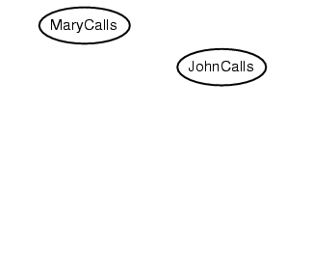
Example
Suppose we choose the ordering M, J, A, B, E
P(J | M) = P(J)?

Slide 85
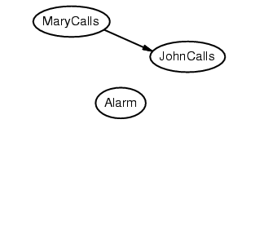
Example
Suppose we choose the ordering M, J, A, B, E
P(J | M) = P(J)? No

Slide 86
Example
Suppose we choose the ordering M, J, A, B, E
P(J | M) = P(J)? No
P(A | J, M) = P(A)?
P(A | J, M) = P(A | J)?
P(A | J, M) = P(A | M)?

Slide 87
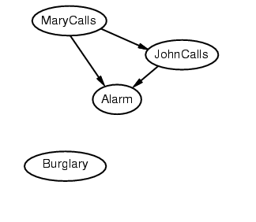
Example
Suppose we choose the ordering M, J, A, B, E
P(J | M) = P(J)? No
P(A | J, M) = P(A)? No
P(A | J, M) = P(A | J)? No
P(A | J, M) = P(A | M)? No

Slide 88
Example
Suppose we choose the ordering M, J, A, B, E
P(J | M) = P(J)? No
P(A | J, M) = P(A)? No
P(A | J, M) = P(A | J)? No
P(A | J, M) = P(A | M)? No
P(B | A, J, M) = P(B)?
P(B | A, J, M) = P(B | A)?

Slide 89
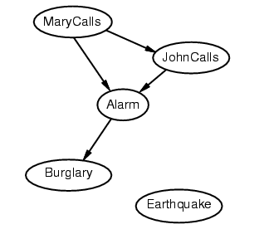
Example
Suppose we choose the ordering M, J, A, B, E
P(J | M) = P(J)? No
P(A | J, M) = P(A)? No
P(A | J, M) = P(A | J)? No
P(A | J, M) = P(A | M)? No
P(B | A, J, M) = P(B)? No
P(B | A, J, M) = P(B | A)? Yes

Slide 90
Example
Suppose we choose the ordering M, J, A, B, E
P(J | M) = P(J)? No
P(A | J, M) = P(A)? No
P(A | J, M) = P(A | J)? No
P(A | J, M) = P(A | M)? No
P(B | A, J, M) = P(B)? No
P(B | A, J, M) = P(B | A)? Yes
P(E | B, A ,J, M) = P(E)?
P(E | B, A, J, M) = P(E | A, B)?

Slide 91
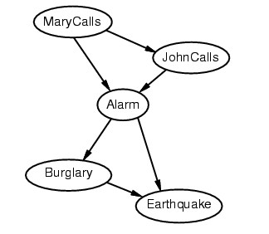
Example
Suppose we choose the ordering M, J, A, B, E
P(J | M) = P(J)? No
P(A | J, M) = P(A)? No
P(A | J, M) = P(A | J)? No
P(A | J, M) = P(A | M)? No
P(B | A, J, M) = P(B)? No
P(B | A, J, M) = P(B | A)? Yes
P(E | B, A ,J, M) = P(E)? No
P(E | B, A, J, M) = P(E | A, B)? Yes

Slide 92
Example: The network we constructed
Deciding conditional independence is hard in non-causal directions
The causal direction seems much more natural
Network is less compact: 1 + 2 + 4 + 2 + 4 = 13 numbers needed

Slide 93
Learning Bayesian Networks from Data
Given a data set, which Bayesian network with variables A, B, C and D best represents the data?
A
B
C
D
or
or
or
A | B | C | D
true | false | false | true
true | false | true | false
true | false | false | true
false | true | false | false
false | true | false | true
false | true | false | false
false | true | false | false
: | : | : | :
A
B
A
?
C
B
D
C
D

Slide 94
Learning Bayesian Networks from Data
Each possible structure contains information about the conditional independence relationships between A, B, C and D
We would like a structure that contains conditional independence relationships that are supported by the data
Note that we also need to learn the values in the CPTs from data
Still an open problem
A
B
C
D
or
or
or
A
B
A
?
C
B
D
C
D

Slide 95
Number of parameters to learn
In a joint distribution table
30 variables
Size?
In a Bayesian network
30 nodes, each with <= 5 parent nodes
Size?
Simplify the representation of each conditional probability table
The noisy-OR model

Slide 96
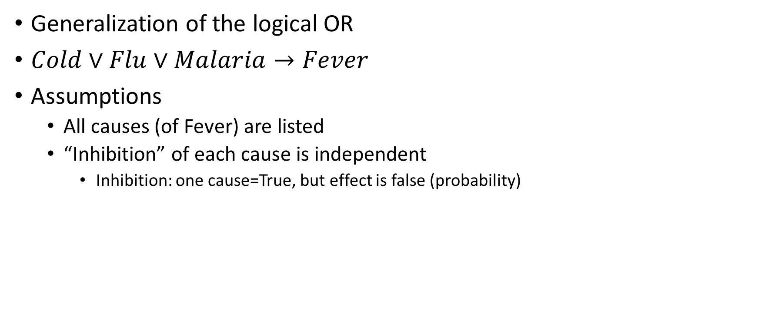
noisy-OR model
Generalization of the logical OR
$Cold∨Flu∨Malaria→Fever$
Assumptions
All causes (of Fever) are listed
“Inhibition” of each cause is independent
Inhibition: one cause=True, but effect is false (probability)

Slide 97
noisy-OR model
Cold Flu Malaria
Fever
A link may be inhibited due to uncertainty

Slide 98
Noisy-OR model
Inhibition probabilities:
P(~fever | cold, ~flu, ~malaria) = 0.6
P(~fever | ~cold, flu, ~malaria) = 0.2
P(~fever | ~cold, ~flu, malaria) = 0.1

Slide 99
Noisy-OR model
Now the whole conditional probability table can be built:
P(~fever | ~cold, ~flu, ~malaria) = 1.0
P(~fever | cold, ~flu, malaria) =
P(~fever | cold, flu, ~malaria) =
P(~fever | ~cold, flu, malaria) =
P(~fever | cold, flu, malaria) =

Slide 100
Noisy-OR model
Now the whole conditional probability table can be built:
P(~fever | ~cold, ~flu, ~malaria) = 1.0
P(~fever | cold, ~flu, malaria) = 0.6 x 0.1
P(~fever | cold, flu, ~malaria) = 0.6 x 0.2
P(~fever | ~cold, flu, malaria) = 0.2 x 0.1
P(~fever | cold, flu, malaria) = 0.6 x 0.2 x 0.1

Slide 101
Classwork: noisy-OR model
P(+cold)
0.4
P(+flu)
0.2
P(+malaria)
0.1
Cold Flu Malaria
Fever
Inhibition probabilities:
P(~fever | cold, ~flu, ~malaria) = 0.6
P(~fever | ~cold, flu, ~malaria) = 0.2
P(~fever | ~cold, ~flu, malaria) = 0.1
Calculate: What is the probability of having Malaria given that Fever is observed?

Slide 102
Bayesian Networks summary
Two important properties:
Is a compact representation of the joint probability distribution over the variables
Encodes the conditional independence relationships between the variables in the graph structure

Slide 103
References
Russel and Norvig, Artificial Intelligence: A Modern Approach, 3rd edition, Prentice Hall, 2010. Chapter 14.1-14.4

